Slide 1
PRESENTING GAME IDEA
BY
TEAM 1

Slide 2
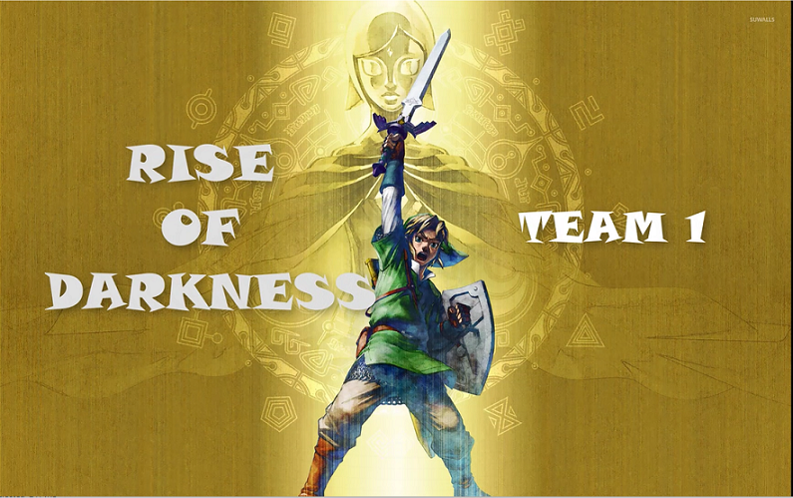

Slide 3
CONTENTS
Game summary
Game Details
Some scenes in game
How to play
Main character’s stats and other character
Inventory and Items system
Shop in game
Development plan in future

Slide 4
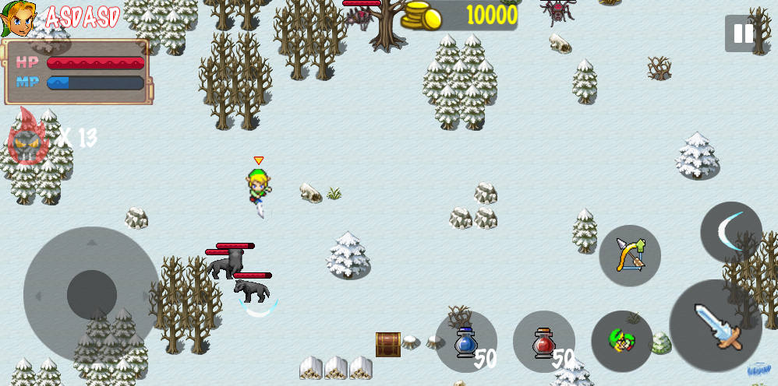
GAME SUMMARY
In summary, rise of darkness is a 2D, ¾ view, action, adventure game where you go through all various places to defeat demons army with various weapons

Slide 5

GAME DETAILS

Slide 6
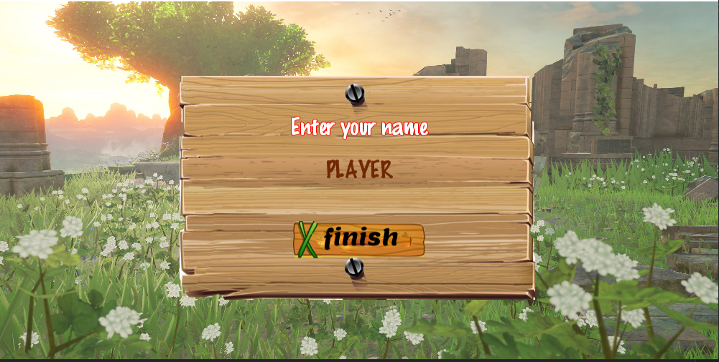
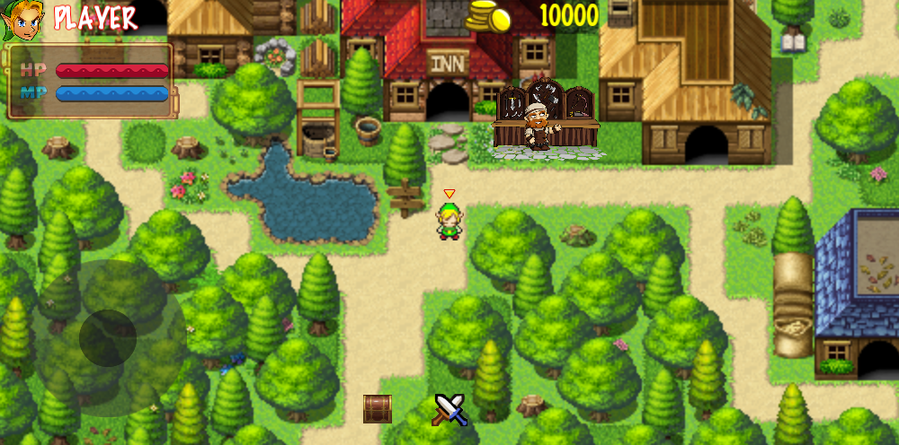
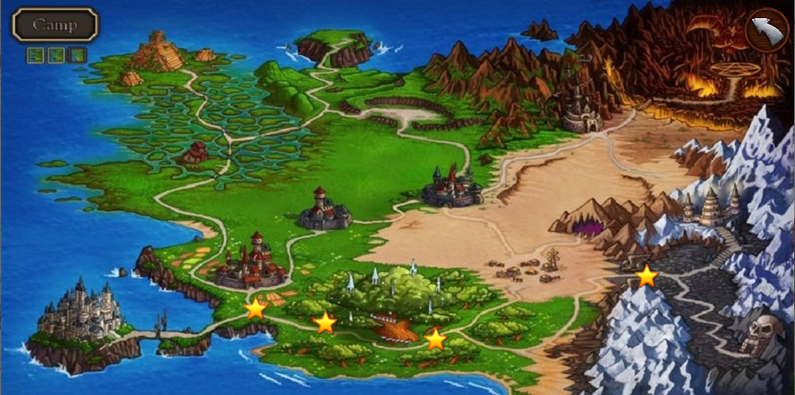
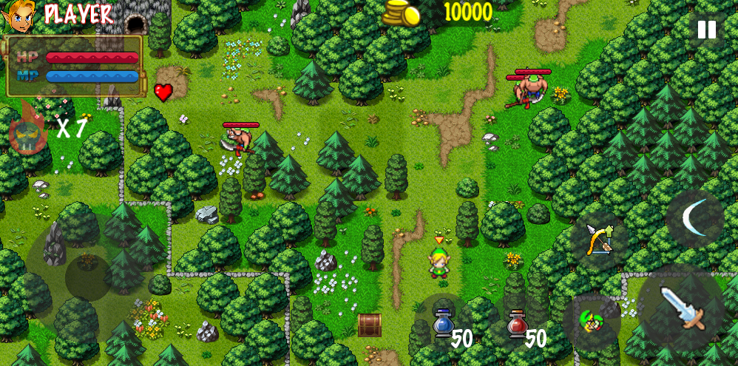
SOME SCENES IN GAME

Slide 7
HOW TO PLAY
Choose game stage

Slide 8
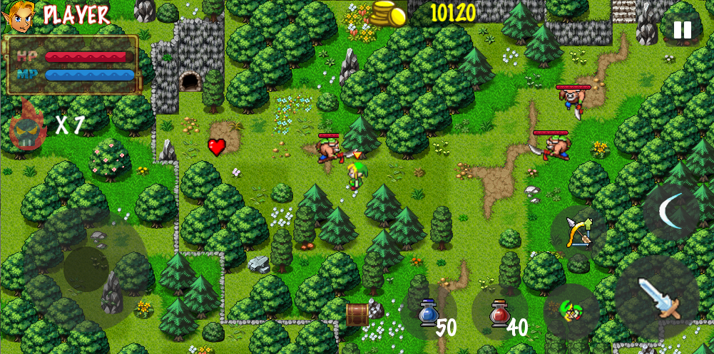
HOW TO PLAY
Defeat all monsters to clear stage

Slide 9
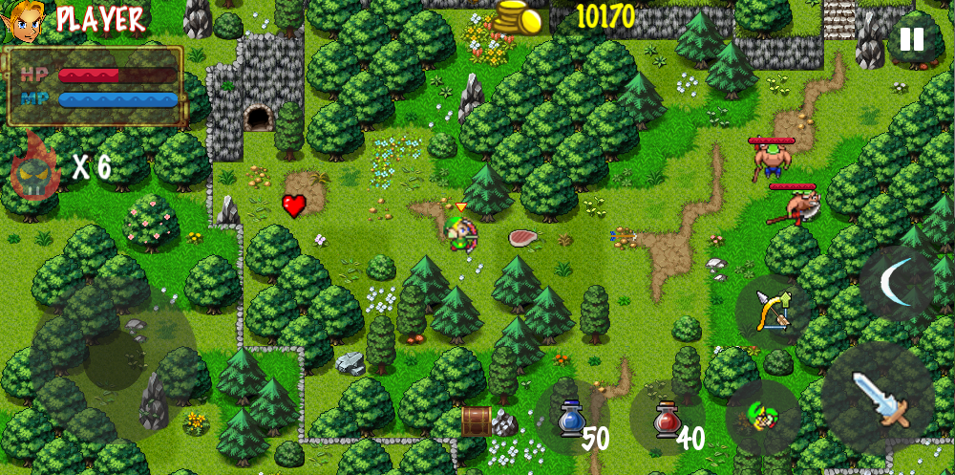
HOW TO PLAY
Earn gold and collect drop items when defeat monsters

Slide 10
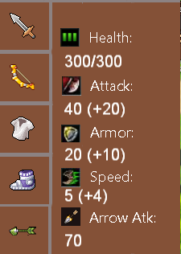
MAIN CHARACTER’S STATS
Stats board

Slide 11




MONSTERS
Health point: Higher is stronger
Attack speed: Higher is stronger
Movement speed: Higher is stronger
Attack range: Melee/Long-range
Static/Dynamic
Monster’s stats

Slide 12


MONSTERS
ENEMY’S TIER LIST
Tier 1
Nokken
Rope
Tier 2
Spear Moblin
Bow Moblin
Tier 3
Warwick
Elise
Maokai

Slide 13










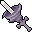

INVENTORY & ITEMS SYSTEM
Potion
Weapon
Armor
Arrow
Boots

Slide 14



INVENTORY & ITEMS SYSTEM
Heart Container item

Slide 15
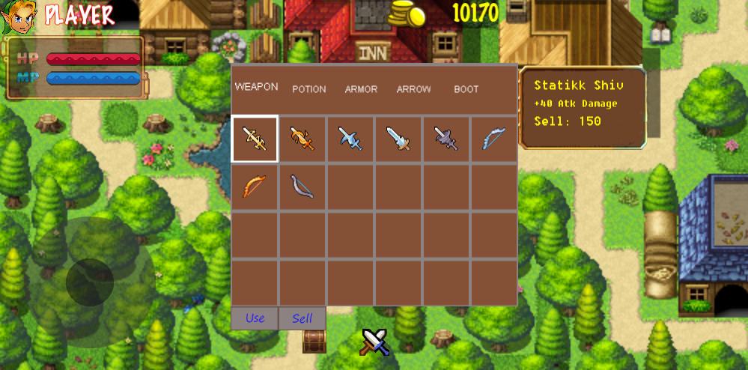
INVENTORY & ITEMS SYSTEM
Inventory

Slide 16
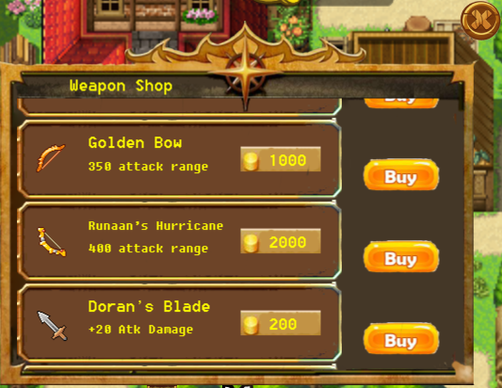
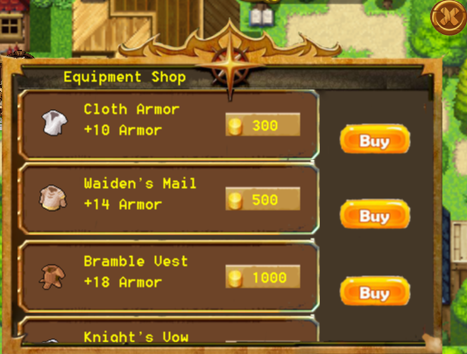
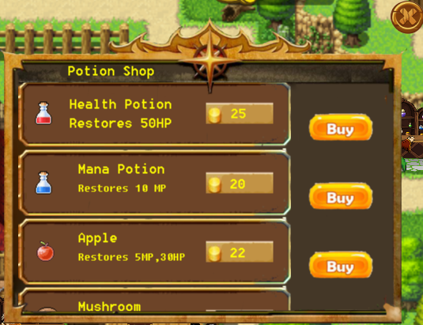
SHOP

Slide 17
DEVELOPMENT PLAN IN FUTURE
Add skills system for specific weapon.
Add combo attack for slash skill.
Crafting items instead of buy directly in shop by materials.
Enhance weapon to unlock new skill.
Add quests system.
Optimize game.
Change outfit of main character when equip new equipment.
Add more effects.

Slide 18
THANKS!

